Slide 1


The application that revolutionizes medical appointment scheduling. Simple, fast, and secure for patients and healthcare professionals.

Slide 2
Table of contents
Project Overview
II. Core functionalities
III. System architecture
IV. Database design
III. System architecture
V. Mobile application UI
VI. Backend and API
VII. Workflow demonstration

Slide 3
Project Overview
01
02
03
Objectives
Modules
Develop a mobile scheduling tool for clinics.
Mobile Development & Web Services.
Target users
Patients, Doctors, Admins.

Slide 4
II. Core functionalities
01
02
03
Patients
Doctors
Register, login, book/cancel appointments.
Set availability, manage appointments.
Admin
Monitor activity, manage users.

Slide 5
III. System architecture
Frontend
Backend
Flutter mobile app.
Node.js/Express REST API.
Database
Auth
MongoDB with Mongoose models.
JWT-based authentication with roles.

Slide 6
IV. Database design
Main Collections
Users, Appointments, Availability.
Relationships via ObjectId references.
See ERD diagram in project documentation.

Slide 7
01
V. Mobile application UI

Slide 8
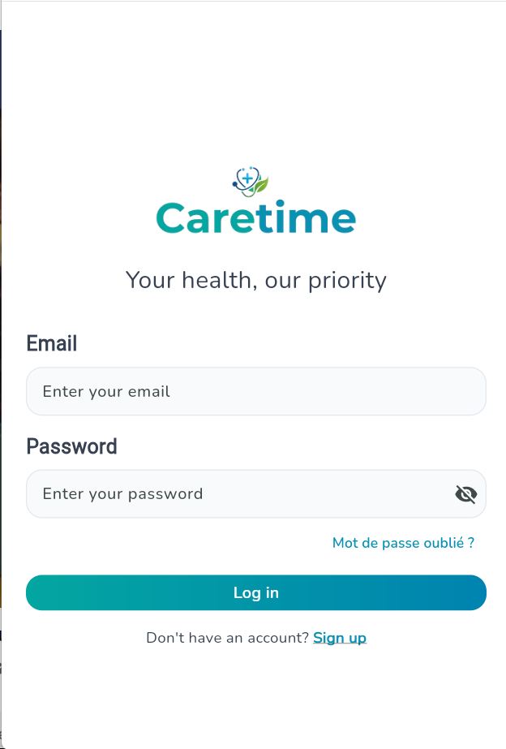
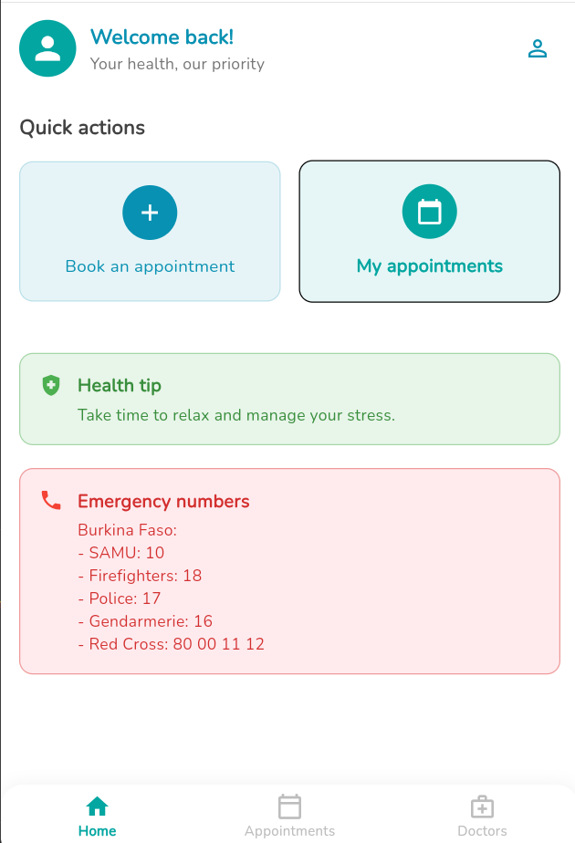
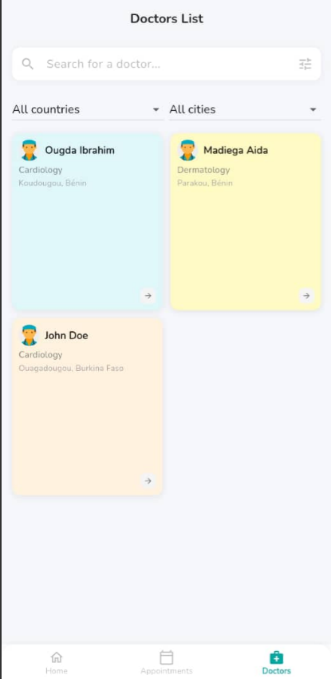
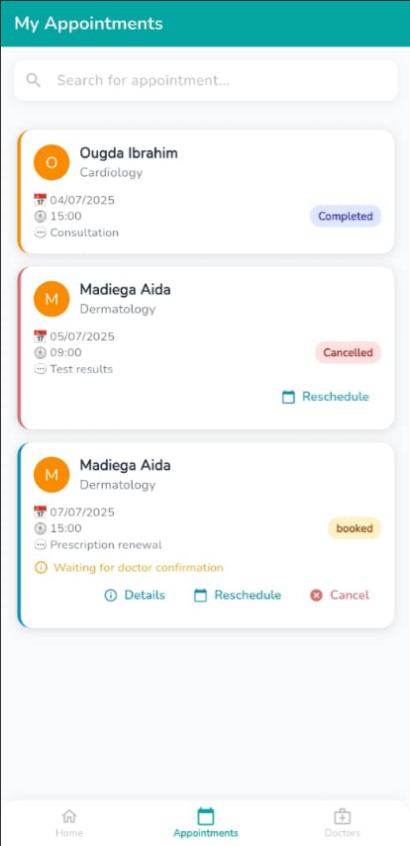
Doctors list
Dashboard Patient
Appointment patient
Login Page

Slide 9
VI. Backend and API
RESTful endpoints for CRUD operations.
Middleware for role access control.
Postman collection provided.
Secure authentication using JWT.

Slide 10
VII. Workflow demonstration
01
02
03
04
Patient registers and logs in.
Doctor sets availability and views calendar.
Books a time slot with a doctor.
Admin monitors users and data.

Slide 11
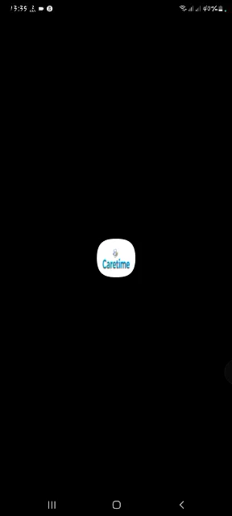

Slide 12
Conclusion
Caretime revolutionizes medical appointment scheduling. Simple, fast, and secure for patients and healthcare professionals.
With caretime , your health ,our priority

